Slide 1


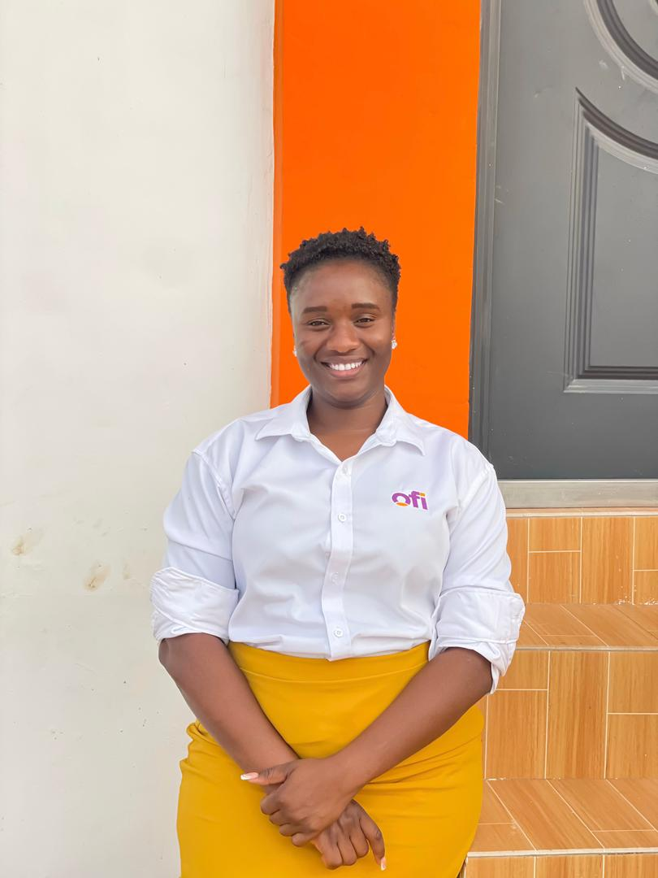

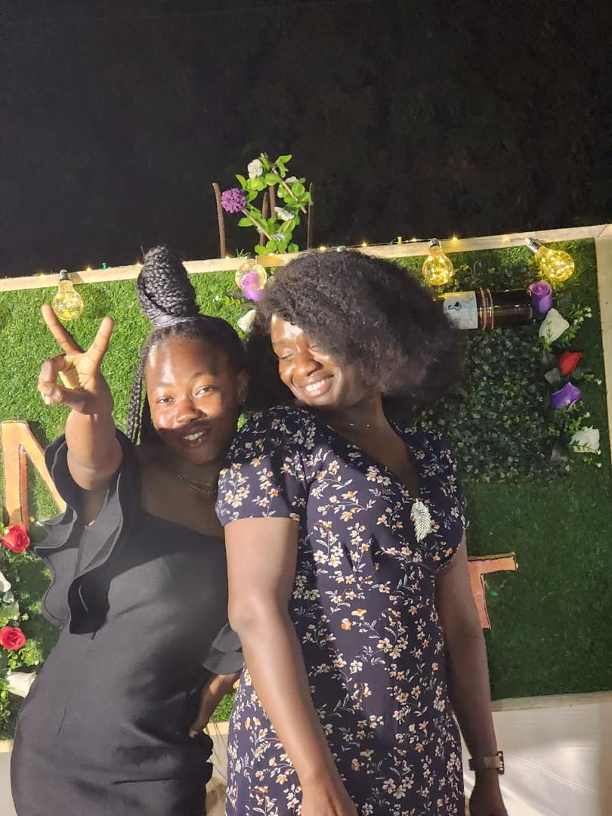
Getting to Know Me
Work
Personal
My role
Sustainability Lead – Ofi cashew
Significant others / family members / furry friends in my life
Mercy Adda
Tenure in ofi/Olam
One (1) year, six (6) months
How I enjoy spending my free time
Watching movies
Previous companies I have worked at
Presbyterian Agricultural Services
My favorite / comfort food
Kenkey with pepper and fish
Why I joined ofi/Olam and what keeps me here?
The opportunity to work with a global leader in the food and agri-business sector, known for its commitment to sustainability and impact in rural communities. This strongly aligns with my personal values of making a difference in the lives of farmers and contributing to food security.
My favorite song
Bloom by Aqyila
First name: Doreen Last name: Abaane
‘what name you prefer to be called’ : Doreen
A few fun facts about me
Cooking relaxes me
This is me outside work, doing stuff I enjoy in my life …

